Slide 1
GROUP 17
DESIGN OF A 16-BIT MICROPROCESSOR UNIT

Slide 2
Outline
Introduction
Instruction set Architecture
Instruction format
Instruction data path.
Hardware Realization
Individual components.

Slide 3

A microprocessor, What is it?

Slide 4
Introduction
The microprocessor is the brain of the computer system,
A single chip that implements a CPU is a microprocessor
The architecture of this processor is based on the MIPS architecture, the most popular implementation of the RISC architecture and inspired by the Intel 8086 microprocessor design.
This processor is designed to be as simple as possible and does not include complex things like pipelining and branch prediction among others.

Slide 5
Instruction set Architecture
The ISA is the blueprint of the microprocessor. It defines the design and structure of the microprocessor as well as its language, instruction formats and instruction types.
This microprocessor can perform 19 instructions which have been categorized into four instruction formats, with each instruction being 18-bits long. The classification is as follows:
R – Type Instruction
I – Type instruction
Memory Instruction
Load Instruction
Store Instruction
Branch Instruction

Slide 6
R - Instructions
The r-type instructions are the instructions performed by the ALU. A total number of 8 instructions are performed by the ALU. These are;
Instruction Format
Op | Rd | Rs | rt | ALUop
3 bits | 4bits | 4 bits | 4 bits | 3 bits
17:15 | 14:11 | 10:7 | 6:3 | 2:0

Slide 7
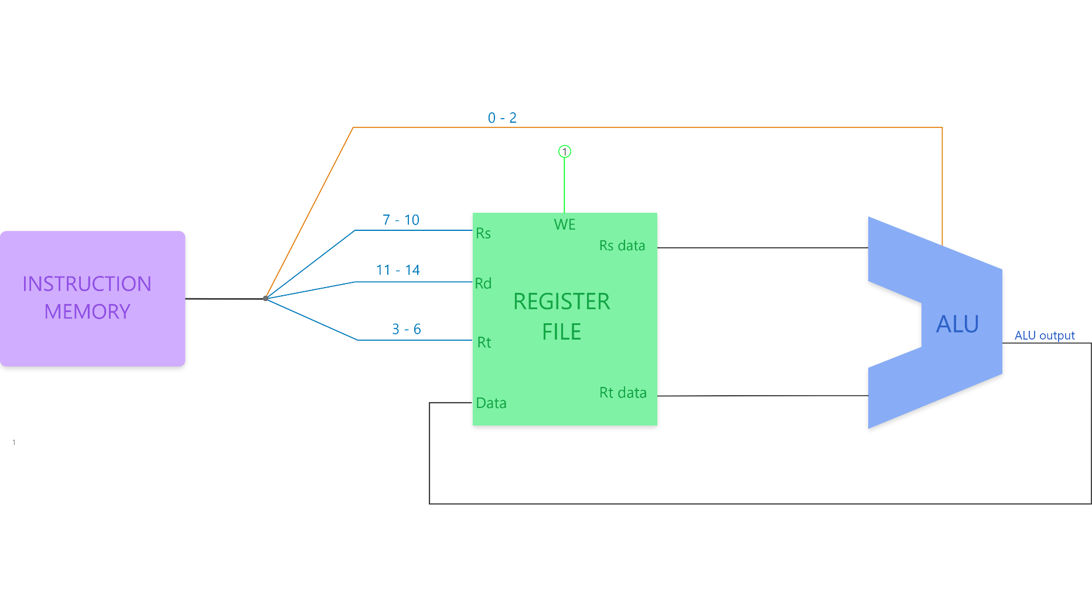
Data path for R-Instruction

Slide 8
I-Type Instruction
The I-type instructions are similar to the r-type instructions except in the I-type, one of the operands is set as a constant whilst the other is taken from the register
Instruction Format
Op | rd | Rs | Immediate | ALUop
3 bits | 4bits | 4 bits | 4 bits | 3 bits
17:15 | 14:11 | 10:7 | 6:3 | 2:0

Slide 9
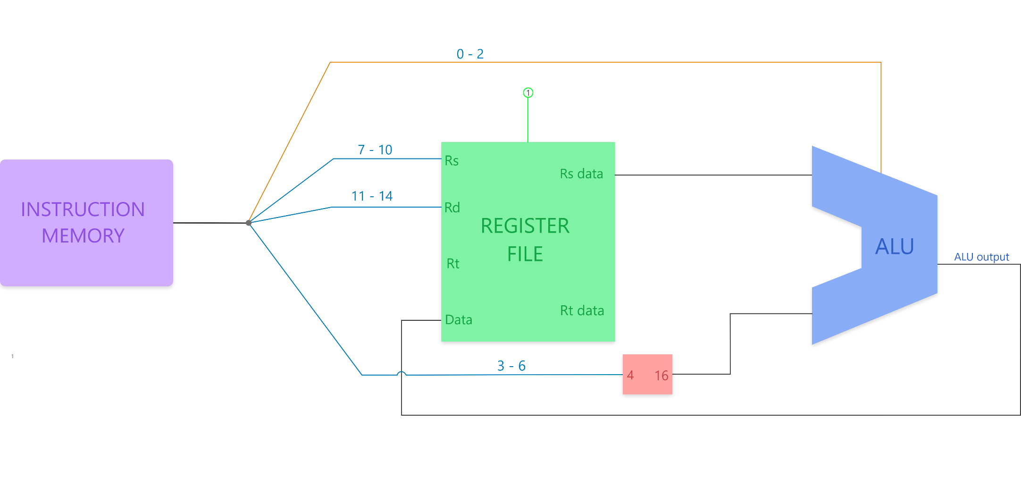
Data Path for I Instructions

Slide 10
Load Instruction
In executing a load, instructions are performed by taking values/data from any of the locations in memory to any of the 16 registers.
Instruction Format
Op | rs | Memory Address
3 bits | 4bits | 11 bits
17:15 | 14:11 | 10:0

Slide 11
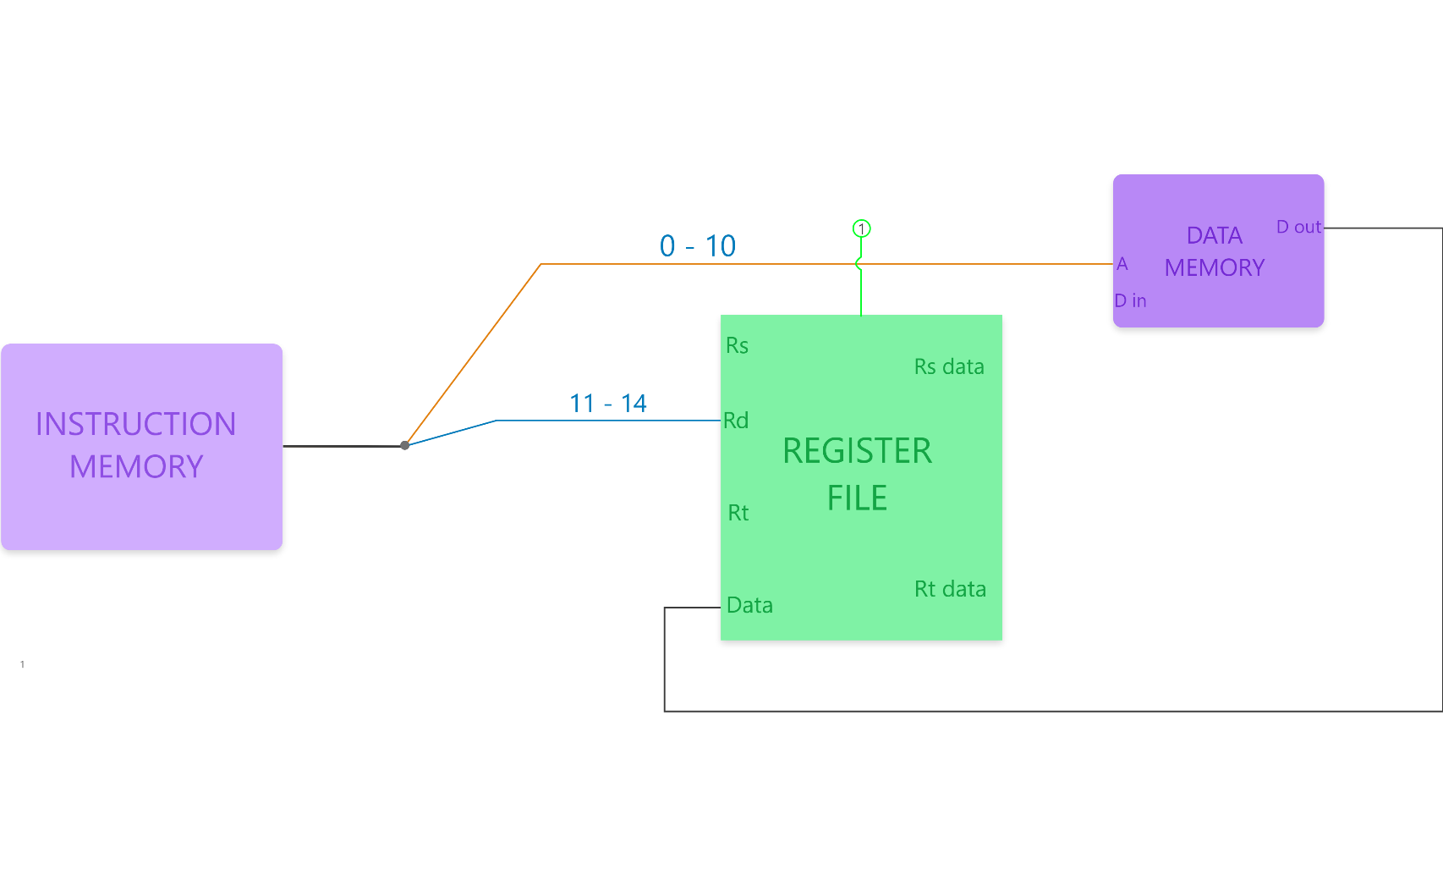
Data path for load Instruction

Slide 12
Store - Instruction
In store, instructions are performed by taking values/data from any of the 16 registers to any of the locations in memory.
Instruction Format
Op | rs | Memory Address
3 bits | 4bits | 11 bits
17:15 | 14:11 | 10:0

Slide 13
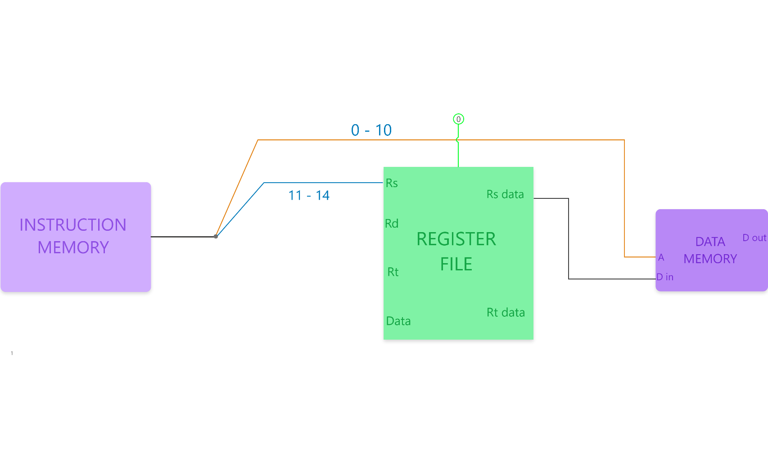
Data path for Store Instruction

Slide 14
Branch Instruction
Branch instructions are those that require the program counter to jump a couple of instruction either forward or backwards as per specifications defines in the instruction.
Instruction Format
Op | rt | rs | Offset
3 bits | 4bits | 4 bits | 7 bits
17:15 | 14:11 | 10:7 | 6:0

Slide 15
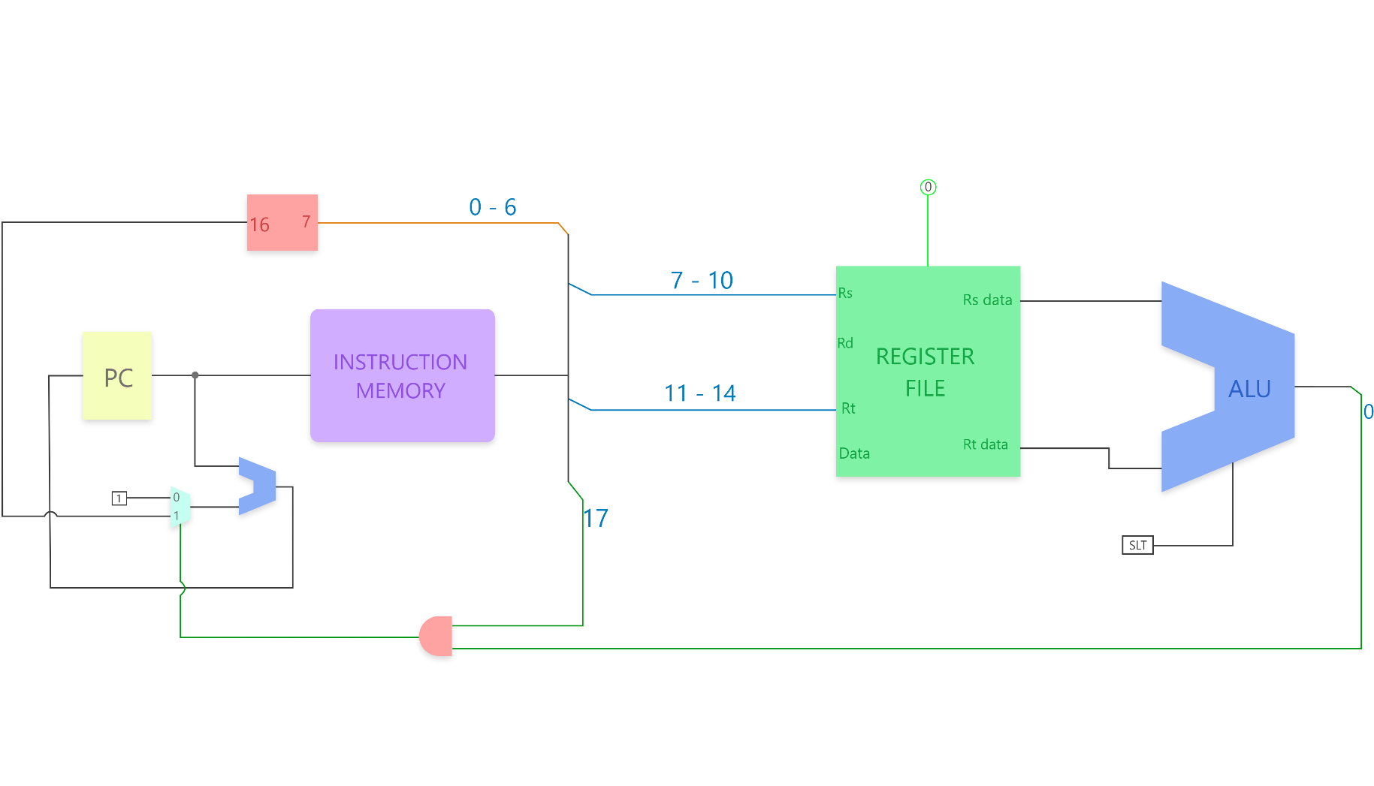
Data path for Branch Instruction

Slide 16
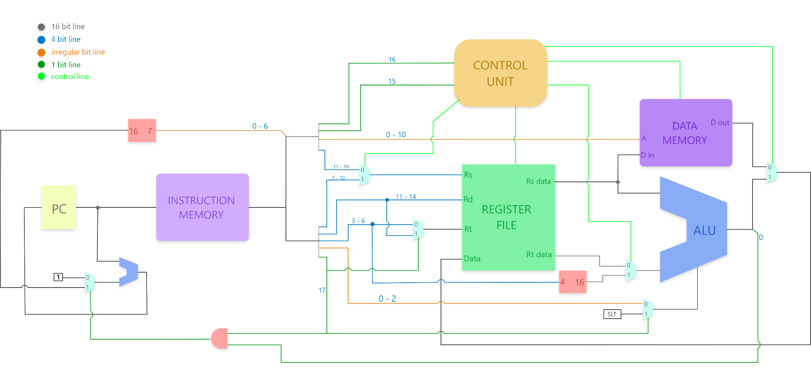
Putting all together

Slide 17
Hardware Realization
The hardware has been designed as a realization of specifications made according to the RISC ISA and the architect’s preferences.
In this section, we will look at the implementation of individual components which include:
Program Counter
Instruction Memory
Register File
ALU
Data Memory
Control Unit

Slide 18
Program Counter
The program counter iterates the instruction memory; it stores the address of the next instruction to be executed after every clock cycle, and increases by one, with the exception of a branch instruction, which increases by a factor specified in the branch instruction.

Slide 19
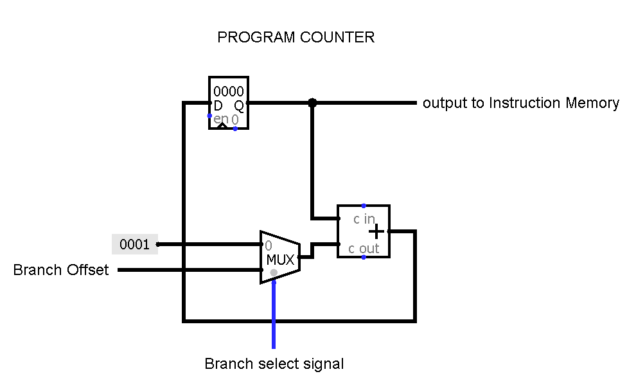
Program Counter Design

Slide 20
Instruction Memory
The instruction memory is a read only memory which basically stores instructions. It depends on the program counter to select the address of the next instruction to be executed on the next clock cycle.

Slide 21
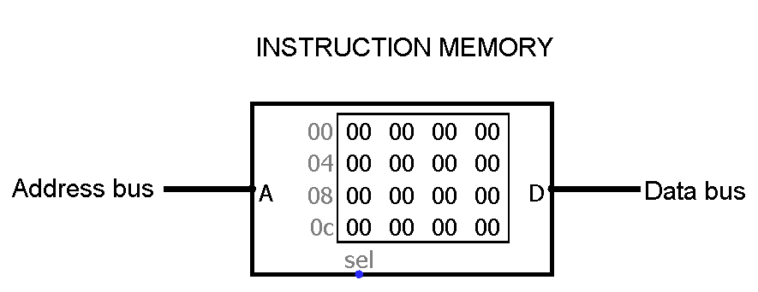
Instruction Memory Design

Slide 22
Register File
The register file is a temporal storage space, which serves as a cache for the main memory. It contains data loaded from memory and It’s used to perform register to register ALU operations.
Our register file consists of sixteen 16-bit registers.

Slide 23
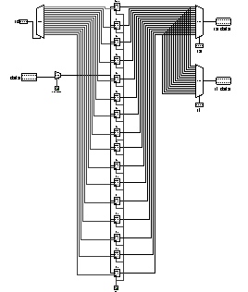
Register File Design

Slide 24
Arithmetic and Logic Unit
The arithmetic and logic unit, ALU, performs the arithmetic and logical operations of the processor. Our ALU performs addition and subtraction as our arithmetic operations.
Also, our processor performs AND, OR, XOR, SEQ, SLT, SGT as its logical operations.

Slide 25
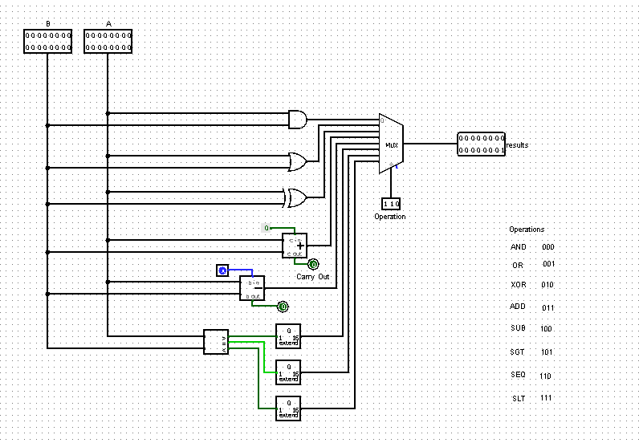
ALU Design
ALU OPERATION | OPCODE
ADD | 000
OR | 001
XOR | 010
ADD | 011
SUB | 100
SGT | 101
SEQ | 110
SLT | 111

Slide 26
Data Memory
Data memory stores data for the operations. The data is loaded into the register file, and stored back into the data memory from the register file after the operations have been performed.

Slide 27
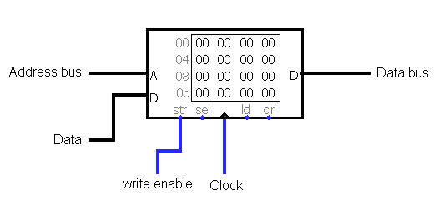
Data Memory Design

Slide 28
Control Unit
The control unit produces control signals to oversee the operations and coordination of various hardware components embedded in the processor.

Slide 29
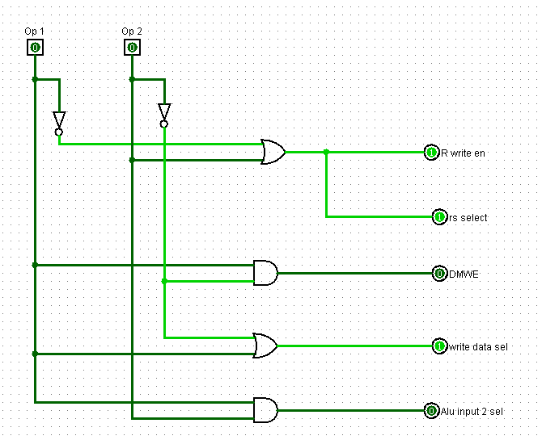
Control Unit Design

Slide 30
Control Signals for the instructions
Operations | Op-Code |  |  | Output
 | Op₁ | Op₂ | Op₃ | rs sel | R-write | Src B sel | DMWE | Write data sel
R-Type | 0 | 0 | 0 | 1 | 1 | 0 | 0 | 1
Load | 0 | 0 | 1 | X | 1 | X | 0 | 0
Store | 0 | 1 | 0 | 0 | 0 | X | 1 | X
I-Type | 0 | 1 | 1 | 1 | 1 | 1 | 0 | 1
Branch | 1 | 0 | 0 | 0 | 0 | 0 | 0 | X

Slide 31
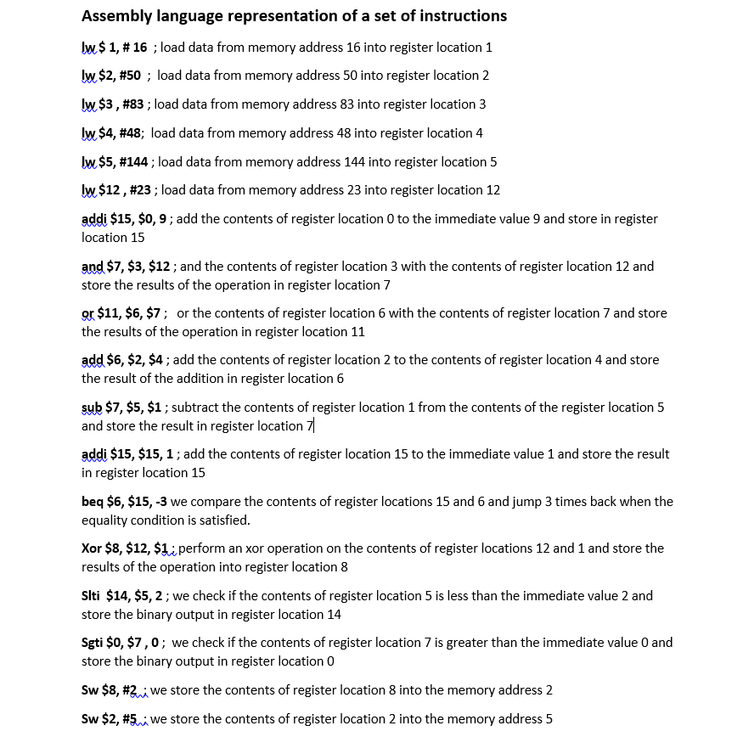
TESTING

Slide 32
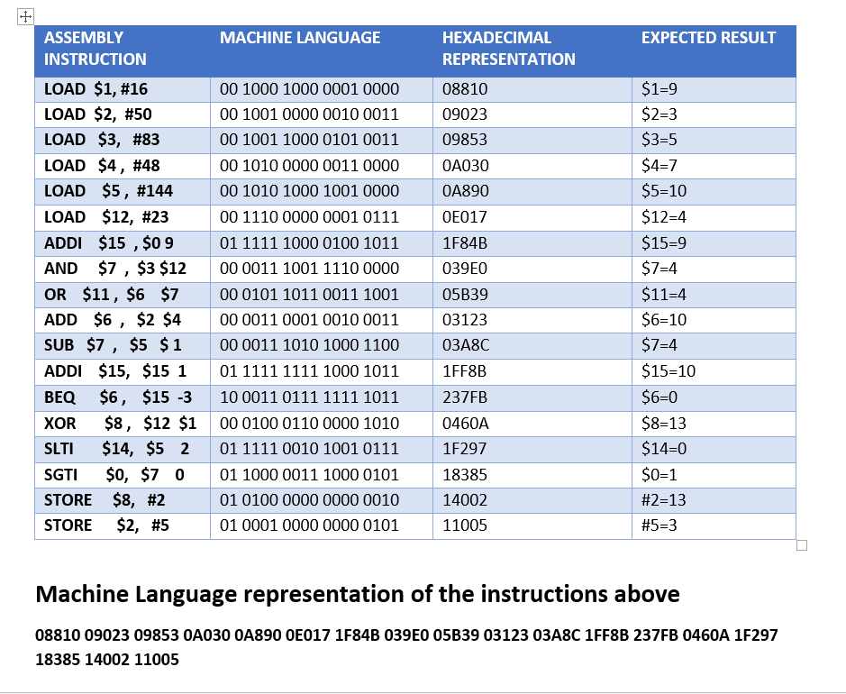
TESTING

Slide 33
Possible Improvements On Current state of Design
Extra addressing modes to allow memory and branch operations address farther than 2^11 locations
Room available for expansion of maximum addressable space
Improvements to decoding strategy of I-type instructions to allow extension of immediate field

Slide 34
THANK YOU

